Slide 1
Lesson 2: Business Modelling I
EMA/IS1 HT 2021 Group 2

Slide 2
Recording
This lesson will be recorded
Please keep your mic off and your camera on!

Slide 3
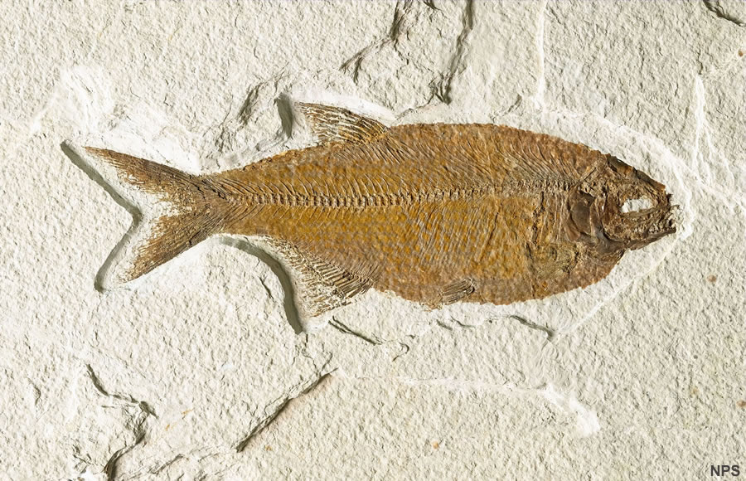

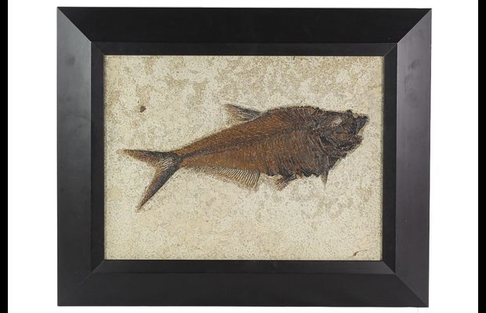
On Fossils and Frames
A company manufactures and sells framed fossils. The company has a number of subunits that autonomously manage procurement and sales. However, some activities are managed centrally, see below. The subunits procure fossils and frames from their suppliers — note that no single supplier can provide both fossils and frames. The fossils to be framed are typically very expensive and are procured one at a time, often after a complex negotiation. The frames, on the other hand, are fairly inexpensive and are ordered in large quantities in order to keep prices down.
The mounting of the frames is made by qualified personnel. When a picture is completed, it is inspected by an inspector in order to guarantee that it holds the highest standards before it is shipped to a customer. The customers usually buy only one fossil at a time, but sometimes one customer orders several pictures simultaneously. In most cases, the customer specifies the kind of fossil desired, e.g. “tooth of Tyrannosaurus Rex”, but sometimes a customer orders a specific fossil. Most pictures are expensive and fragile and they are, therefore, shipped directly to the customer by the company’s own personnel who for this purpose use the company cars.
The company employs central personnel for mounting and delivery of pictures. Furthermore, the company centrally purchases the cars used at the deliveries.

Slide 5
Applying the REA Ontology
What economic agents are there?
What economic resources are there?
Which agents control them?
What economic events are there?
Which economic events are dual?
What commitments are made?
What contracts are made?
What is needed on the knowledge level?

Slide 6
Economic Agents and Economic Resources
company manufactures
Sub Unit
Fossil
Company
Frame
Picture
Customer
Cash
Frame Supplier
Employee
Car
Service
Fossil Supplier

Slide 7
Room 1: Economic Agents and Economic Resources
fossils
Inspector
frame
Framed fossil
money

Slide 8
Applying the REA Ontology
What economic agents are there?
What economic resources are there?
Which agents control them?
What economic events are there?
Which economic events are dual?
What commitments are made?
What contracts are made?
What is needed on the knowledge level?
Now only for the frames!

Slide 9
Subunit
Frame Supplier
from
from
Purchasing
to
to
Order
Payment
Delivery
Room 6:
Frame Delivery
Frame Payment
dual
Room 1: Cash<>Frame Shipment
Duality
Payment
Resources
Cash
Frame

Slide 10
Applying the REA Ontology
What economic agents are there?
What economic resources are there?
Which agents control them?
What economic events are there?
Which economic events are dual?
What commitments are made?
What contracts are made?
What is needed on the knowledge level?
Now only for the frames!

Slide 12
Applying the REA Ontology
What economic agents are there?
What economic resources are there?
Which agents control them?
What economic events are there?
Which economic events are dual?
What commitments are made?
What contracts are made?
What is needed on the knowledge level?
Now only for the frames!

Slide 13

Purchasing
Has participant
Has participant
Commitment: order lines
Contract: order
Commitment: payment, delivery in time
Contract: receipt
Subunit
Frame Order
Frame Supplier
Room 1:
Contract
Commitment: Payment
Commitment: delivery in time
quality
Frame Delivery Orderline
Frame Payment Orderline
reserves
reciprocity
Room 6: Procurement, frame supplier, delivery,
Contract: Payment terms
Contract: Delivery Terms
fulfils
fulfils
Frame Type
dual
Frame Payment
Frame Delivery
Frame
Cash

Slide 14
Applying the REA Ontology
What economic agents are there?
What economic resources are there?
Which agents control them?
What economic events are there?
Which economic events are dual?
What commitments are made?
What contracts are made?
What is needed on the knowledge level?
Now for the fossils!

Slide 15
Has participant
Has participant
Subunit
Fossil Order
Fossil Supplier
Fossil Delivery Orderline
Fossil Payment Orderline
Room 1:
Exchange frames for fossils. No need for specific fossil types
reciprocity
fulfils
fulfils
Fossil Type
dual
Fossil Payment
Fossil Delivery
reserves
Fossil
Cash

Slide 16
Has participant
Has participant
Subunit
Fossil Order
Fossil Supplier
Fossil Delivery Orderline
Fossil Payment Orderline
Room 1:
Exchange frames for fossils. No need for specific fossil types.
reserves
reciprocity
fulfils
fulfils
Fossil Type
Fossil Payment
Fossil Delivery
reserves
dual
Fossil
Cash

Slide 18
Applying the REA Ontology
What economic agents are there?
What economic resources are there?
Which agents control them?
What economic events are there?
Which economic events are dual?
What commitments are made?
What contracts are made?
What is needed on the knowledge level?
Now for the pictures!

Slide 19
Purchasing
Has participant
Picture Order
Has participant
Subunit
Customer
Picture Delivery Orderline
Picture Payment Orderline
reserves
reciprocity
Picture Type
fulfils
fulfils
reserves
Picture Delivery
dual
Picture Payment
Picture
Fossil
Cash
Frame

